Slide 1
Session 8

Slide 2
Plots
Simple Scatter Plots
Visualizing Errors
Contour Plots
Histograms
Binnings and Density
Customizing Plot Legends

Slide 3
Simple Scatter Plots
Points are not connected with lines.
Each data point has the value of the x-axis and the value from the y-axis .
It is basically an X, Y coordinate plots i.e. between two numerical data columns which can be helpful to track down the regression line.
This type of plot can be used to display trends or correlations.

Slide 4
Simple Scatter Plots
If the data forms a band extending from lower left to upper right, there most likely a positive correlation between the two variables.
If the band runs from upper left to lower right, a negative correlation is probable.
If it is hard to see a pattern, there is probably no correlation.

Slide 5
Why Scatter Plot?
Show the relationship between two variables
It helps to get a compact data visualization.
It is useful when looking for outliers or for understanding the distribution of your data.

Slide 6
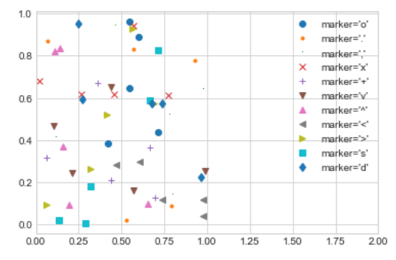
Example of Simple Scatter Plot
import matplotlib.pyplot as plt
plt.style.use('seaborn-whitegrid')
import numpy as np
rng = np.random.RandomState(0)
for marker in ['o', '.', ',', 'x', '+', 'v', '^', '<', '>', 's', 'd']:
plt.plot(rng.rand(5), rng.rand(5), marker,
label="marker='{0}'".format(marker))
plt.legend(numpoints=1)
plt.xlim(0, 2);

Slide 7
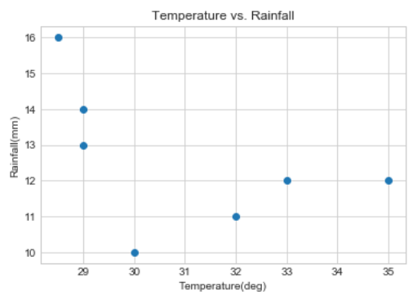
Example of Simple Scatter Plot
import matplotlib.pyplot as plt
temp = [30, 32, 33, 28.5, 35, 29, 29]
rainfall_perhour = [10, 11, 12, 16, 12, 14, 13]
plt.scatter(temp,rainfall_perhour )
plt.title("Temperature vs. Rainfall")
plt.xlabel("Temperature(deg)")
plt.ylabel("Rainfall(mm)")
plt.show()

Slide 8
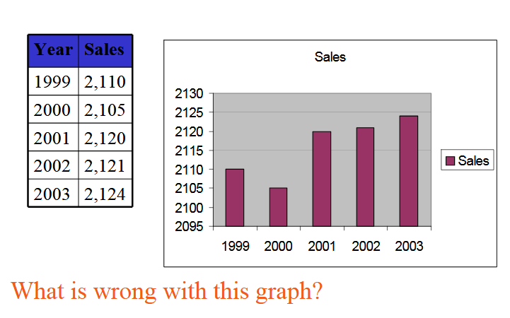
Bad Visualization

Slide 9
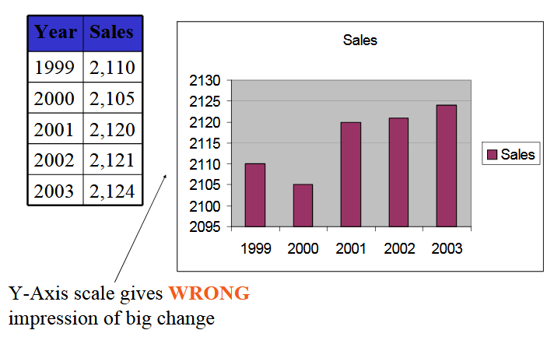
Better Visualization

Slide 10
Error Visualization
Find accurate errors is important, accurate reporting of the number itself.
A basic error bar can be used to represent the error.
Sometime desirable to show error bars on continuous quantities.

Slide 11
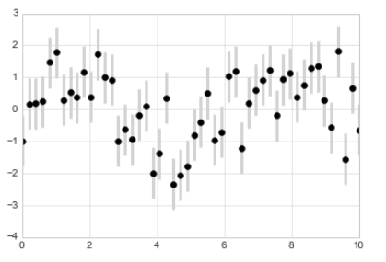
Example
plt.errorbar(x, y, yerr=dy, fmt='o', color='black', ecolor='lightgray', elinewidth=3, capsize=0);

Slide 12
Contour Plots
Display three-dimensional data in two dimensions using contours or color-coded regions.
A contour plot can be created with the plt.contour function. It takes three arguments: a grid of x values, a grid of y values, and a grid of z values.
The x and y values represent positions on the plot, and the z values will be represented by the contour levels.

Slide 13
Why use Contour Plot?
Contour plots display the results of a single data set (time step, load step, or substep) over the model geometry.
It is mainly used for three dimensional plot.

Slide 14
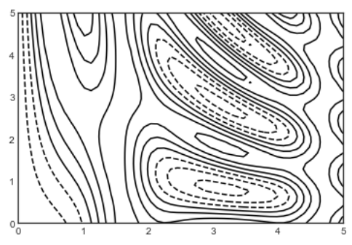
Example of Contour Plot
import matplotlib.pyplot as plt
plt.style.use('seaborn-white')
import numpy as np
def f(x, y):
return np.sin(x) ** 10 + np.cos(10 + y * x) * np.cos(x)
x = np.linspace(0, 5, 50)
y = np.linspace(0, 5, 40)
X, Y = np.meshgrid(x, y)
Z = f(X, Y)
plt.contour(X, Y, Z, colors='black');

Slide 15
Histograms
A representation of the distribution of numeric data over a continuous interval or certain time period.
The continuous variable shown on the X-axis is broken into discrete intervals and the number of data you have in that discrete interval determines the height of the bar.
Combination of a vertical bar chart and a line chart.
To create a histogram, first, we divide the entire range of values into a series of intervals, and second, we count how many values fall into each interval.

Slide 16
Why use Histogram?
To make comparisons in data sets over an interval or time
To show a distribution of data
To estimate as to where values are concentrated, what the extremes are and whether there are any gaps or unusual values throughout the data set.

Slide 17
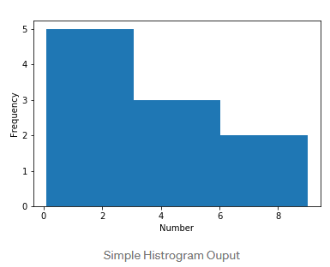
Example of Histogram
numbers = [0.1, 0.5, 1, 1.5, 2, 4, 5.5, 6, 8, 9]
plt.hist(numbers, bins = 3)
plt.xlabel("Number")
plt.ylabel("Frequency")
plt.show()

Slide 18
Binning
The intervals are also called bins.
The bins are consecutive and non-overlapping intervals of a variable.
They must be adjacent and are often of equal size.

Slide 19
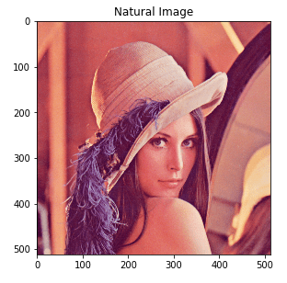
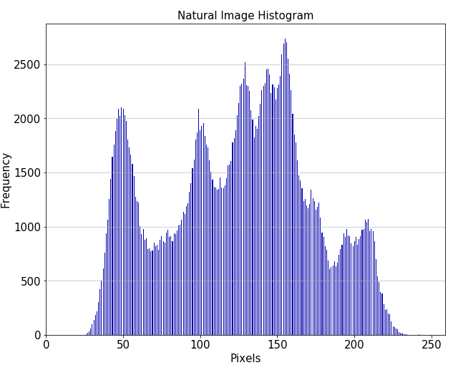
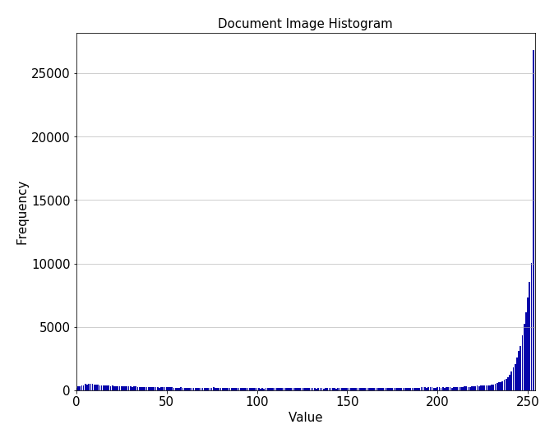
Plotting Image Histogram

Slide 20
Density Plot
A Density plot is a smoothed, continuous version of a histogram estimated from the data.
The most common form of estimation is known as kernel density estimation.
In this method, a continuous curve (the kernel) is drawn at every individual data point and all of these curves are then added together to make a single smooth density estimation.

Slide 21
Why Density Plot?
It visualizes the distribution of data over a continuous interval or time period.
This chart is a variation of a Histogram that uses kernel smoothing to plot values, allowing for smoother distributions by smoothing out the noise.
The peaks of a Density Plot help display where values are concentrated over the interval.
Density Plots have over Histograms is that they're better at determining the distribution shape because they're not affected by the number of bins used (each bar used in a typical histogram).

Slide 22
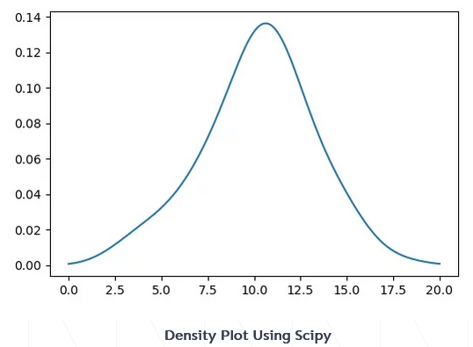
Example of Density Plot
import numpy as np
import matplotlib.pyplot as plt
from scipy.stats import gaussian_kde
data = np.random.normal(10,3,100) # Generate Data
density = gaussian_kde(data)
x_vals = np.linspace(0,20,200) # Specifying the limits of our data
density.covariance_factor = lambda : .5 #Smoothing parameter
density._compute_covariance()
plt.plot(x_vals,density(x_vals))
plt.show()

Slide 23
Kernel Density Estimation(KDE)
A method for visualizing the distribution of observations in a dataset,
Analogous to a histogram.
KDE represents the data using a continuous probability density curve in one or more dimensions.

Slide 24
Why Use KDE?
Estimation of probability density function
Enabling the user to better analyze the studied probability distribution than when using a traditional histogram

Slide 25
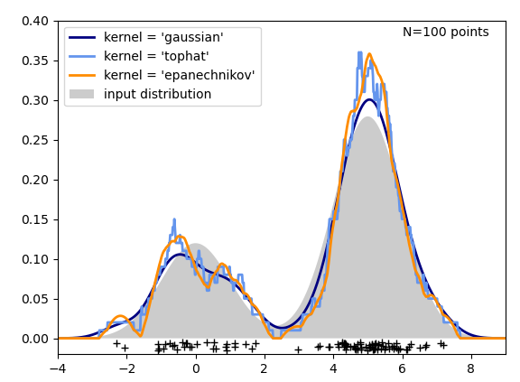
Example of KDE
# tophat KDE kde = KernelDensity(kernel='tophat', bandwidth=0.75).fit(X) log_dens = kde.score_samples(X_plot) ax[1, 0].fill(X_plot[:, 0], np.exp(log_dens), fc='#AAAAFF') ax[1, 0].text(-3.5, 0.31, "Tophat Kernel Density") # Gaussian KDE kde = KernelDensity(kernel='gaussian', bandwidth=0.75).fit(X) log_dens = kde.score_samples(X_plot) ax[1, 1].fill(X_plot[:, 0], np.exp(log_dens), fc='#AAAAFF') ax[1, 1].text(-3.5, 0.31, "Gaussian Kernel Density")

Slide 26
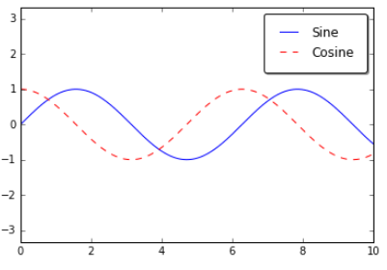
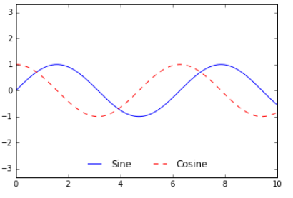
Plot Legends
Plot legends give meaning to a visualization, assigning meaning to the various plot elements.
Positions of the legends

Slide 27
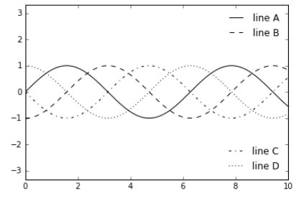
Multiple Legends
ax.legend(lines[:2], ['line A', 'line B'], loc='upper right', frameon=False)
import Legend leg = Legend(ax, lines[2:], ['line C', 'line D'], loc='lower right', frameon=False) ax.add_artist(leg);

